Slide 1
CSS Basics

Slide 2
CSS is a language that describes the style of an HTML document.
CSS describes how HTML elements should be displayed.

Slide 3

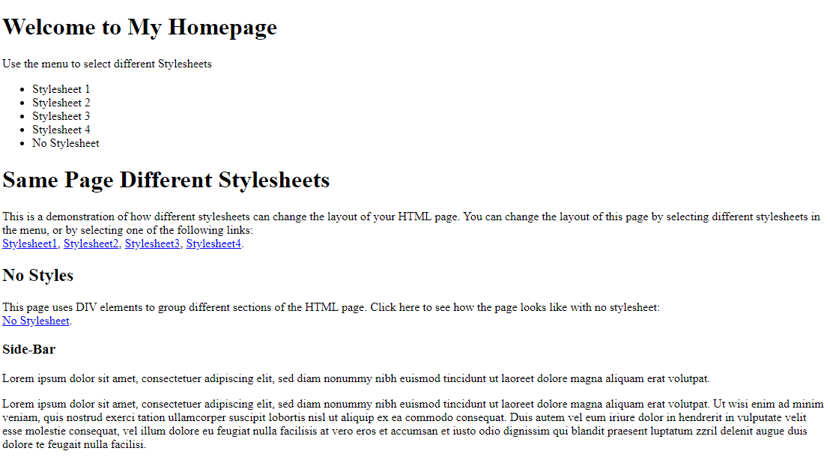
No styles
No style sheet applied

Slide 4
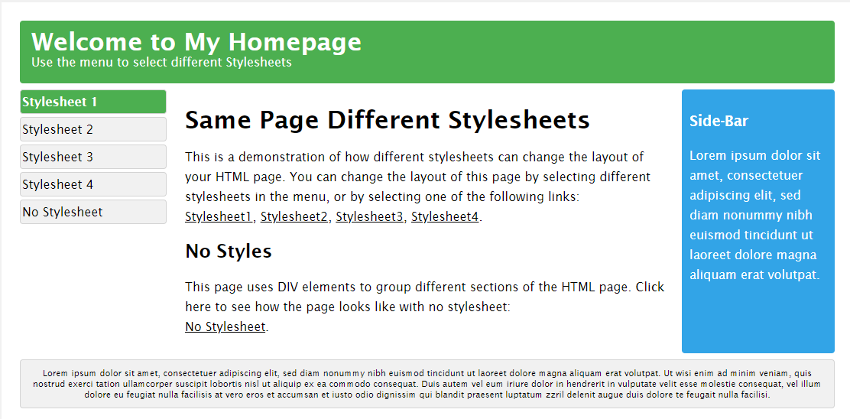
Different Style

Slide 5
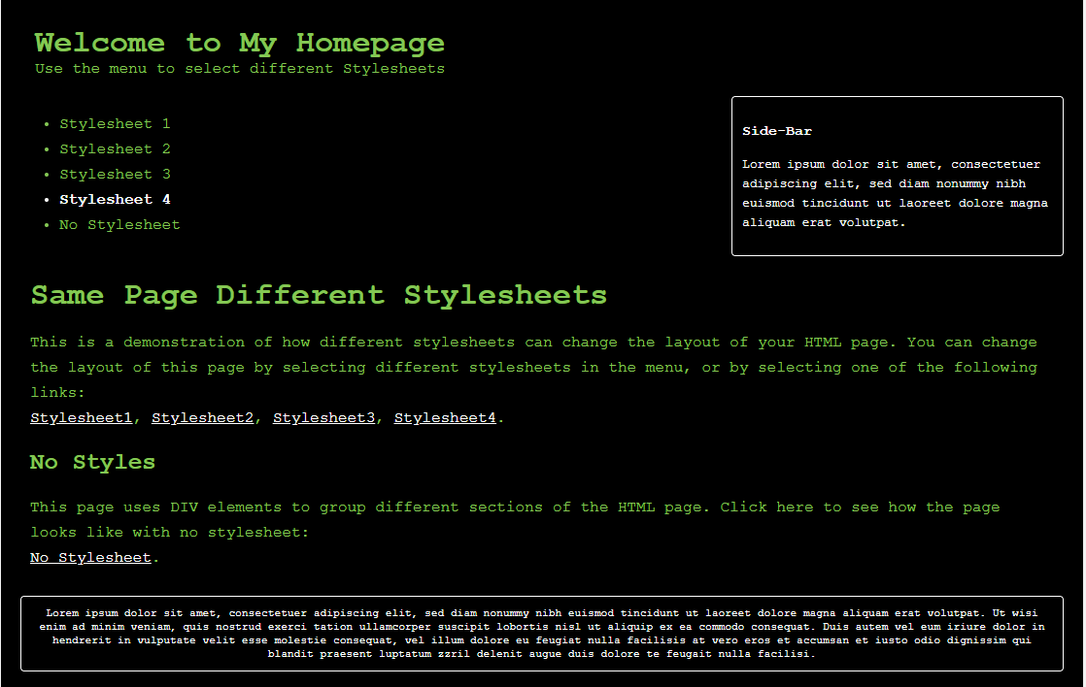
Different Style (again)

Slide 6
Observation
Dramatically changed the display of the page
The HTML is exactly the same
The stylesheet (.CSS) is the only thing that changes

Slide 7
Stylesheets
You can define stylesheets 3 places
In-line
Internal
External (we’re going to do it this way)

Slide 8
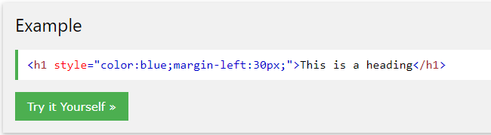
Inline

Slide 9
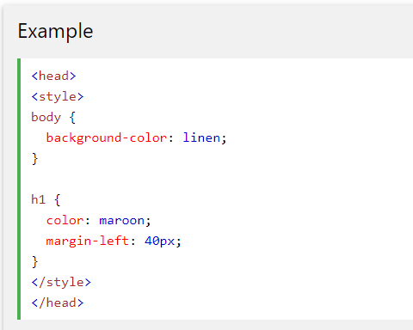
Internal

Slide 10
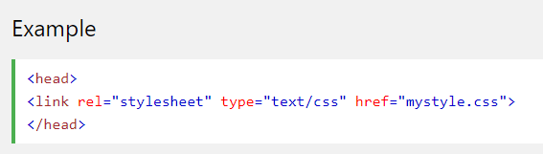
External

Slide 11
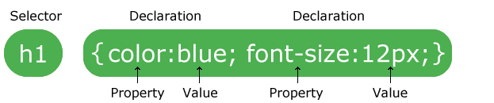
Stylesheet basics
Selectors and declarations
Declarations always end with semicolos
Blocks are surrounded with burly braces

Slide 12

The CSS Box Model
This helps remind you of where things go
“Outline” can be drawn around the border.

Slide 13
Text
Color
Text-align
Fonts
Generic
Font-family
Fallback

Slide 14
Links
A:link
A:visited
A:hover
A:active

Slide 15
In class “assignment” – VS Code
Open VS Code
Draft an HTML Document
A title
At least two heading types
2 or more paragraphs
A list or a table
A link
Add a stylesheet
Add some elements of color
Add a border around something
Change a font
Do something with alignment, padding, or margins

